Slide 1
Introduction to Data
Data is a collection of information gathered by observations, measurements, research or analysis. They may consist of facts, numbers, names, figures or even description of things. Data is organized in the form of graphs, charts or tables.

Slide 2
Difference Between Data and Information
Data | Information
Data is unorganised and unrefined facts | Information comprises processed, organised data presented in a meaningful context
Data is an individual unit that contains raw materials which do not carry any specific meaning. | Information is a group of data that collectively carries a logical meaning.
Data doesn’t depend on information. | Information depends on data.
Raw data alone is insufficient for decision making | Information is sufficient for decision making
An example of data is a student’s test score | The average score of a class is the information derived from the given data.

Slide 3
How data is useful for us?
Music, Shows, and Movies. ...
Healthcare and medical services. ...
Shopping and Marketing. ...
Travel and Transportation. ...
Public Policy and Safety. ...
News and Information. ...
Education and Employment. ...
Artificial Intelligence

Slide 4
What is big data?
Big data refers to data that is so large, fast or complex that it's difficult or impossible to process using traditional methods. The act of accessing and storing large amounts of information for analytics.
some examples are transaction processing systems, customer databases, documents, emails, medical records, internet clickstream logs, mobile apps and social networks.has been around for a long time.
Types Of Big Data
Following are the types of Big Data:
Structured
Unstructured
Semi-structured

Slide 5
Difference between Structured, Semi-structured and Unstructured data
Structured data – Structured data is data whose elements are addressable for effective analysis. It has been organized into a formatted repository that is typically a database. It concerns all data which can be stored in database SQL in a table with rows and columns. They have relational keys and can easily be mapped into pre-designed fields. Today, those data are most processed in the development and simplest way to manage information. Example: Relational data.
Semi-Structured data – Semi-structured data is information that does not reside in a relational database but that has some organizational properties that make it easier to analyze. With some processes, you can store them in the relation database (it could be very hard for some kind of semi-structured data), but Semi-structured exist to ease space. Example: XML data.
Unstructured data – Unstructured data is a data which is not organized in a predefined manner or does not have a predefined data model, thus it is not a good fit for a mainstream relational database. So for Unstructured data, there are alternative platforms for storing and managing, it is increasingly prevalent in IT systems and is used by organizations in a variety of business intelligence and analytics applications. Example: Word, PDF, Text, Media logs.

Slide 6
Differences between Structured, Semi-structured and Unstructured data:
Properties | Structured data | Semi-structured data | Unstructured data
Technology | It is based on Relational database table | It is based on XML/RDF(Resource Description Framework). | It is based on character and binary data
Transaction management | Matured transaction and various concurrency techniques | Transaction is adapted from DBMS not matured | No transaction management and no concurrency
Version management | Versioning over tuples,row,tables | Versioning over tuples or graph is possible | Versioned as a whole
Flexibility | It is schema dependent and less flexible | It is more flexible than structured data but less flexible than unstructured data | It is more flexible and there is absence of schema
Scalability | It is very difficult to scale DB schema | It’s scaling is simpler than structured data | It is more scalable.
Robustness | Very robust | New technology, not very spread | —
Query performance | Structured query allow complex joining | Queries over anonymous nodes are possible | Only textual queries are possible

Slide 7
What are quantitative data and qualitative data?
Quantitative data – Quantitative data is data that can be counted or measured in numerical values. The two main types of quantitative data are discrete data and continuous data. Height in feet, age in years, and weight in pounds are examples of quantitative data.
Qualitative data - Qualitative data is information that cannot be counted, measured or easily expressed using numbers. It is collected from text, audio and images and shared through data visualization tools, such as word clouds, concept maps, graph databases, timelines and infographics.

Slide 8
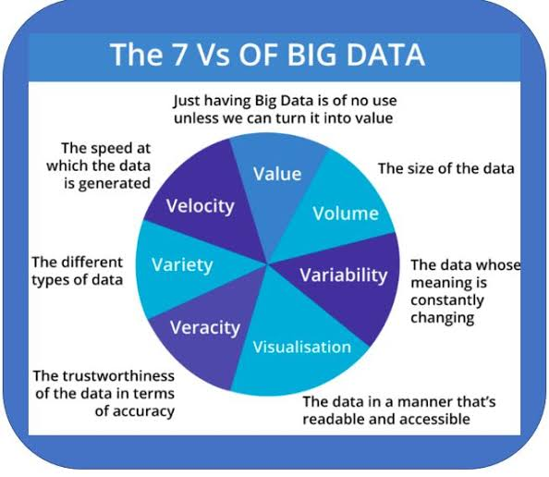
What are the different V’s in big data?

Slide 9
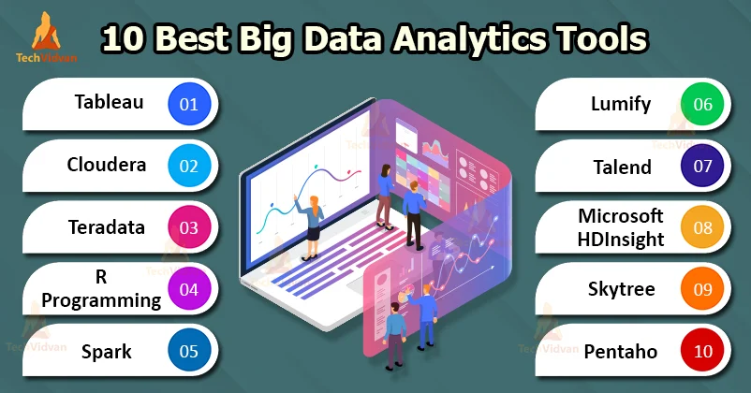
Name some popular tools used in big data

Slide 10
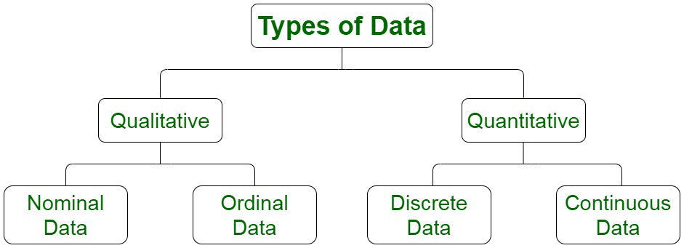
Different types of data

Slide 11
Qualitative data-
Qualitative Data
Qualitative data is used to represent some characteristics or attributes of the data. The facts and figures depicted by the qualitative data cannot be computed. These properties reflect observable attributes. These are non-numerical in nature. The qualitative data characteristics are exploratory on a larger end than being conclusive in nature. For instance, data on attributes such as honesty, loyalty, wisdom, and creativity for a set of persons defined can be considered as qualitative data.
Examples:
Attitudes of people to a political system.
Music and art
Intelligence
Beauty of a person

Slide 12
Nominal data-
Nominal Data
Nominal data is a sub-category belonging to one of the types of qualitative information. Also known as the nominal scale, it is used to label the variables without providing the numerical value for them. Nominal data attributes can’t either be ordered or measured. The nominal data can be both qualitative and quantitative in nature. For instance, some of the nominal data attributes are letters, symbols or gender, etc.
Examples:
Gender (Women, Men)
Eye color (Blue, Green, Brown)
Hair color (Blonde, Brown, Brunette, Red, etc.)
Marital status (Married, Single)
Religion (Muslim, Hindu, Christian)

Slide 13
Ordinal data-
Ordinal Data
Ordinal data/variable is the specific type of data that follows a natural order. The difference between the data values is not determined in the case of nominal data. For instance, ordinal data variable is mostly found in surveys, economics, questionnaires, and finance operations.
The examination of the nominal data is based on the usage of visualization tools. The visualization of this data is done using the bar chart. The ordinal data can be expressed in the form of tables which have each row corresponding to the distinct category.
Examples:Feedback is recorded in the form of ratings from 1-10.
Education level: elementary school, high school, college.
Economic status: low, medium, and high.
Letter grades: A, B, C, and etc.
Customer level of satisfaction: very satisfied, satisfied, neutral, dissatisfied, very dissatisfied.

Slide 14
Quantitative data-
Quantitative Data
Quantitative data can be measured and is not just observable. The measurement of data is numerically recorded and represented. Calculations and interpretations can then be performed on the obtained results. Numerical data is indicated by quantitative data. For instance, data can be recorded about how many users found a product satisfactory in terms of the collected rating, and therefore, an overall product review can be generated.
Examples:
Daily temperature
Price
Weights
Income

Slide 15
Discreate data-
Discrete Data
Discrete data refers to the data values which can only attain certain specific values. Discrete data can’t attain a range of values. Discrete data can be represented using bar charts. For instance, ratings of a product made by the users can only be in discrete numbers.
Examples:
The number of students in a class,
The number of chips in a bag,
The number of stars in the sky

Slide 16
Continuous data-
Continuous Data
Continuous Data can contain values between a certain range that is within the highest and lowest values. The corresponding difference between the highest and lowest value of these intervals can be termed as the range of data. Continuous data can be tabulated in what is called a frequency distribution. The frequency distribution table can be computed for the range type of data. It can also be depicted using histograms. For example, the heights of the students in the class can be largely varying in nature, therefore, they can be divided into ranges to summarise the data.
Examples:
Height and weight of a student,
Daily temperature recordings of a place
Wind speed measurement

